Slide 1
PRESENTATION
we know how to preserve the soul of plants
so that she connects with your

Slide 2
your immune system
time to support

Slide 3
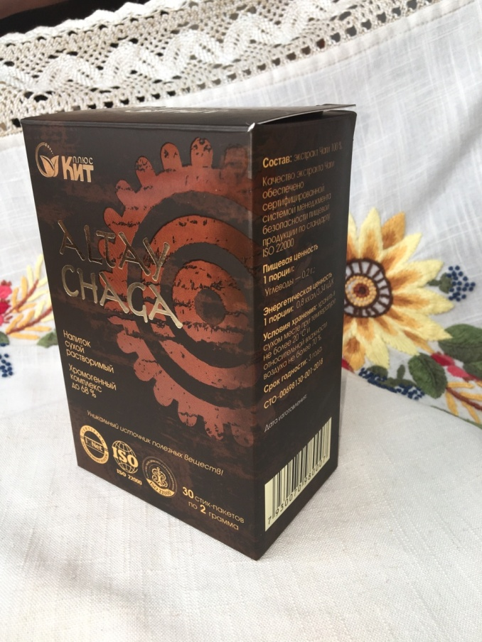
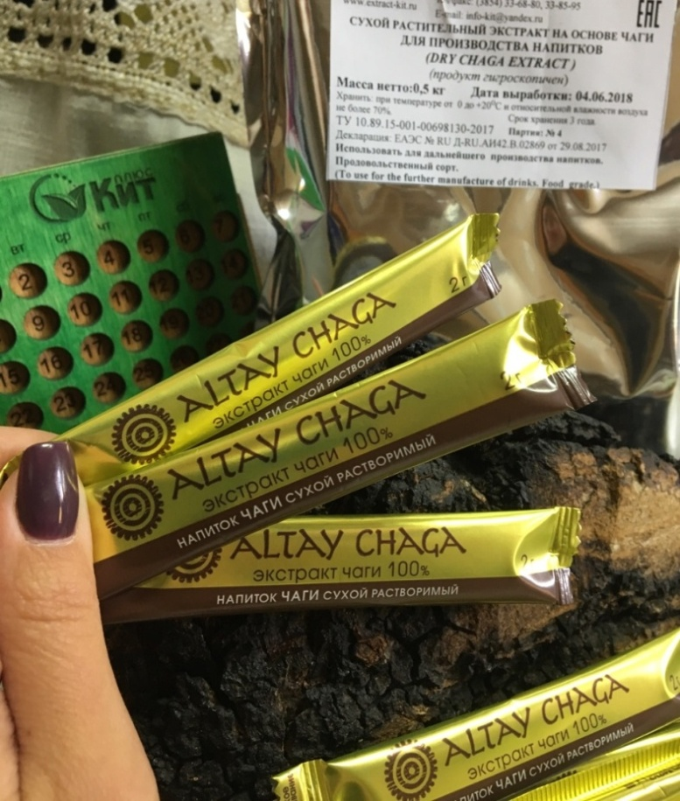
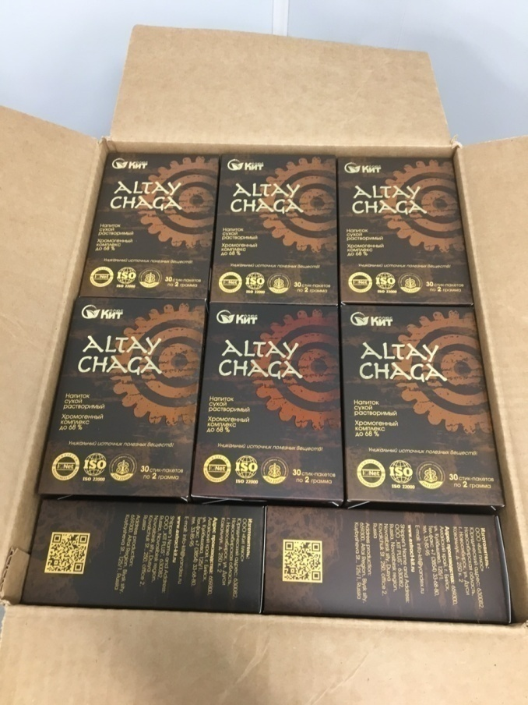
Packaging

Slide 4
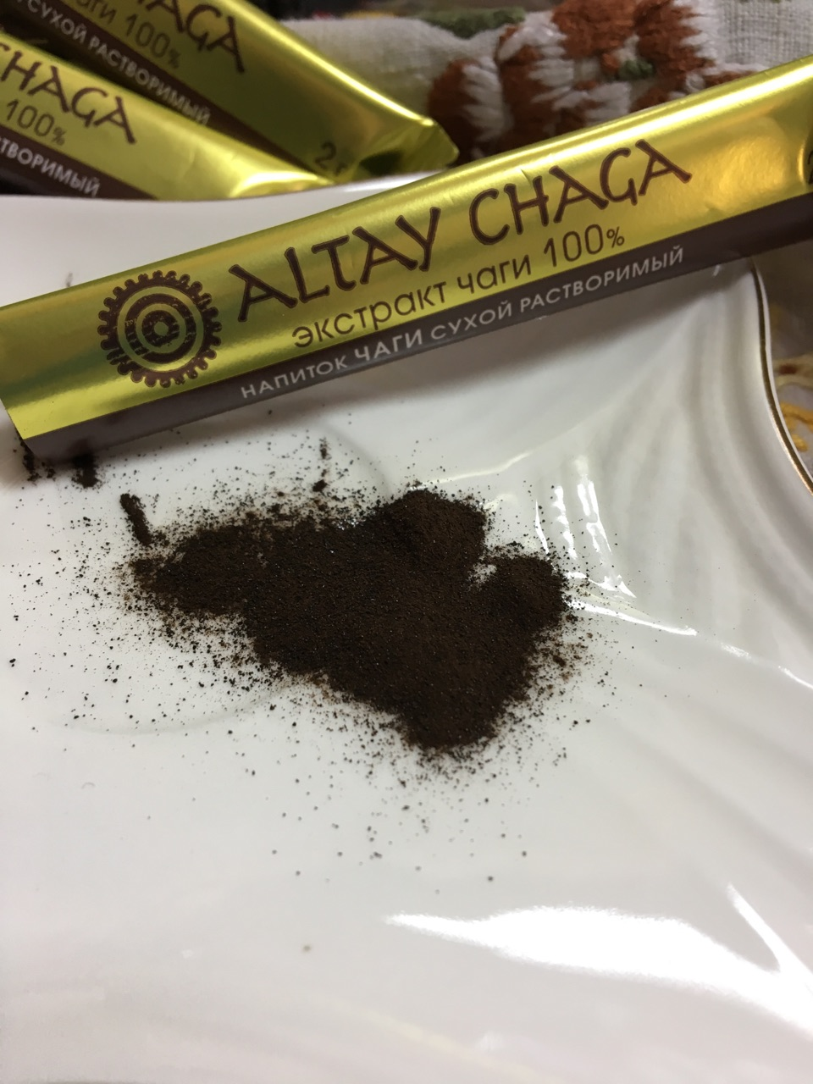
Our products are packaged in modern, comfortable sticks, which have a number of advantages:
good elasticity;
resistance to mechanical damage;
good barrier properties;
preservation of the presentation;
high temperature resistance.

Slide 5
Product information
Dry instant drink "Altay Chaga" (ALTAY CHAGA).
Ingredients: 100% Chaga extract.
"ALTAY CHAGA" (Altai Chaga) is:
- up to 68% content of the chromogenic complex - a powerful biostimulant that has a positive effect on the metabolism in the human body;
- unique elements with the most significant value for human health (polysaccharides, triterpenes (betulin and betulinic acid) and polyphenols (tannins and flavonoids);
- a full range of minerals, vitamins and amino acids necessary for a person;
- a combination of biologically active substances and antioxidants.

Slide 6
Product information
Regular consumption of "ALTAY CHAGA" drink is:
- prevention of oncological and gastrointestinal diseases;
- strengthening the immune system;
- restoration of body strength after injuries;
- stabilizes blood sugar levels;
- reduces the risk of developing diabetes.
"ALTAY CHAGA" - natural color, unique dense woody aroma, astringency and rich taste of the prepared drink.

Slide 7
Cooking method
Recommendations for use: Dissolve 1 stick package (2 g) "ALTAY CHAGA" in a glass (200 ml) of warm or cool water, milk, coffee 40-70 degrees. C. Wait 1 - 2 minutes for the complete dissolution of the Chaga extract. Take 1 - 3 sticks daily. To taste and desire "ALTAY CHAGA" can be added to coffee, milk, ice cream, juices, yoghurts, vegetable and fruit salads and any other ready-made dishes.

Slide 8
We export to countries such as:
South Korea;
Japan;
Czech;

Slide 9
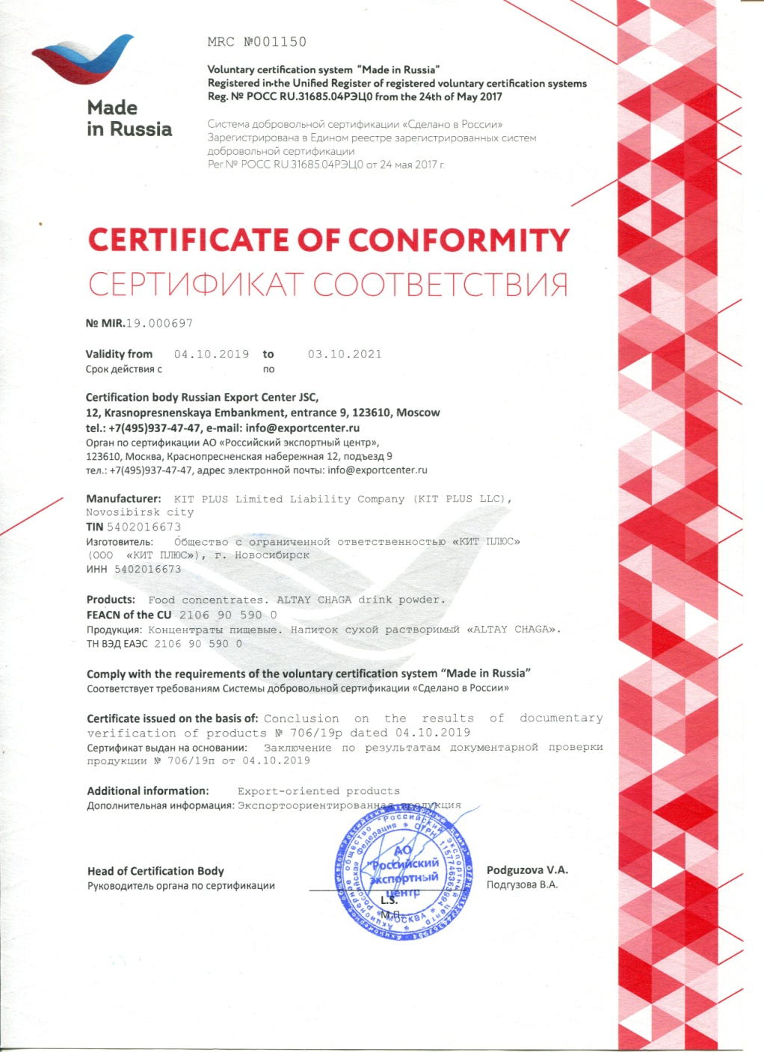
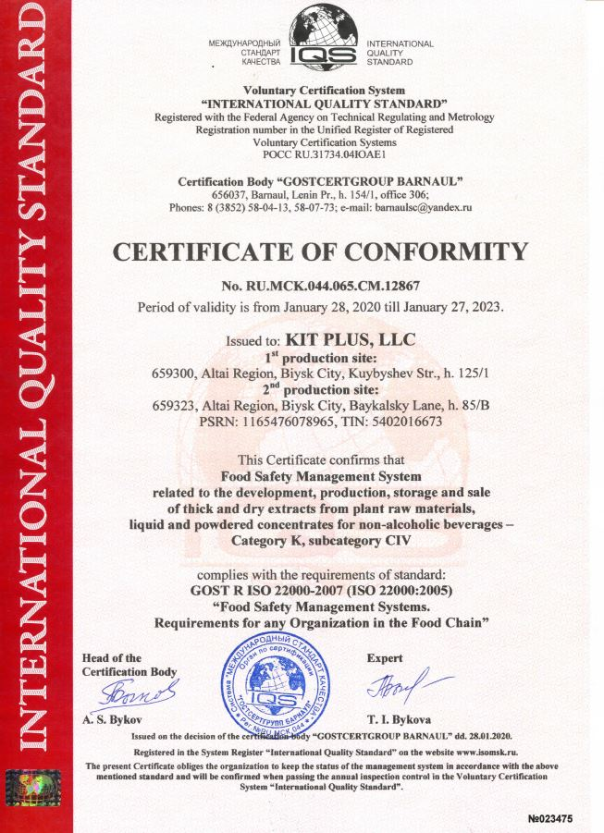

Slide 10
CONTACTS
OUR SOCIAL MEDIA PAGES:
https://www.facebook.com/altay.chaga.50/
https://www.instagram.com/altay_chaga/
https://www.youtube.com/channel/UCOOXTWpmLpQaQHKo2aRh9Lw?view_as=subscriber
https://altaychaga.ru/
+7-3854-33-68-80
info@altaychga.tu

